Slide 1

Working with PDF Files
Notes:
NOTE:
To change the image on this slide, select the picture and delete it. Then click the Pictures icon in the placeholder to insert your own image.

Slide 2
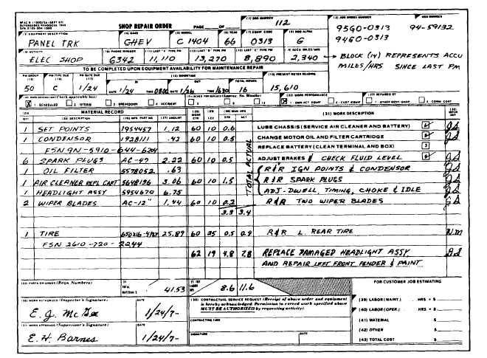
Data Sets That Include PDFs
Scanned records exist in historical data (e.g. aircraft design drawings, maintenance records).
Contain “gold” in many cases.
Easy for humans to read – not so much for computers
Not easy to get into a usable form for data analytics work.

Slide 3
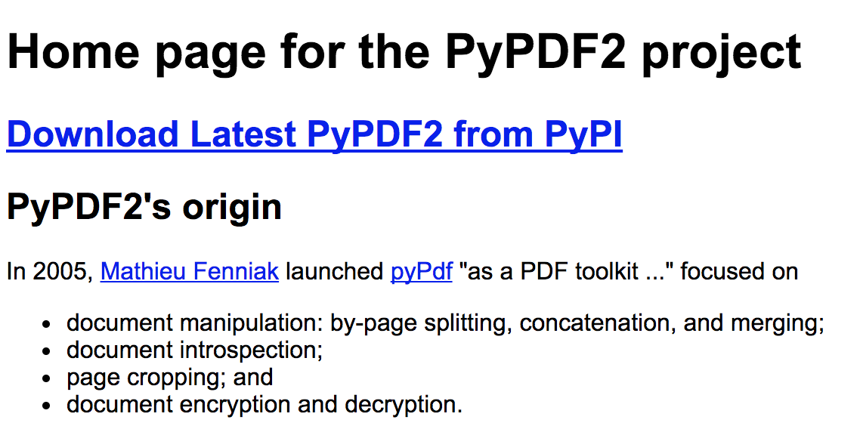

PyPDF2 Package Lightens the PDF-parsing Load Somewhat
Home Page: http://mstamy2.github.io/PyPDF2/http://mstamy2.github.io/PyPDF2/
Example in Automate the Boring Stuff, Chapter 13: https://automatetheboringstuff.com/chapter13/
Some Available Methods:
getPage(n) follows Python indexing convention, not what page number is listed on a PDF page.
extractText()
.write(Output file name)
.rotateClockwise(x) and .rotateCounterClockwise(x) where x is 90, 180, or 270 integer values

Slide 4
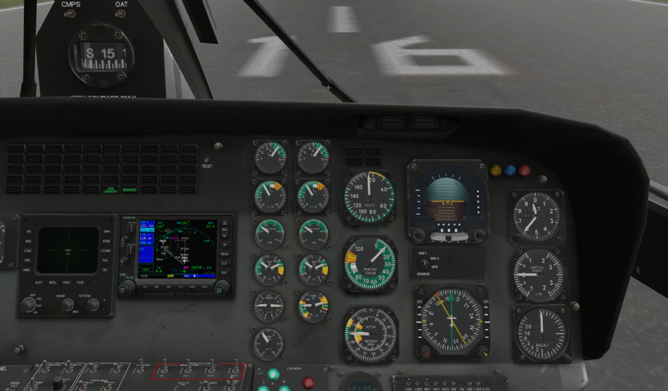
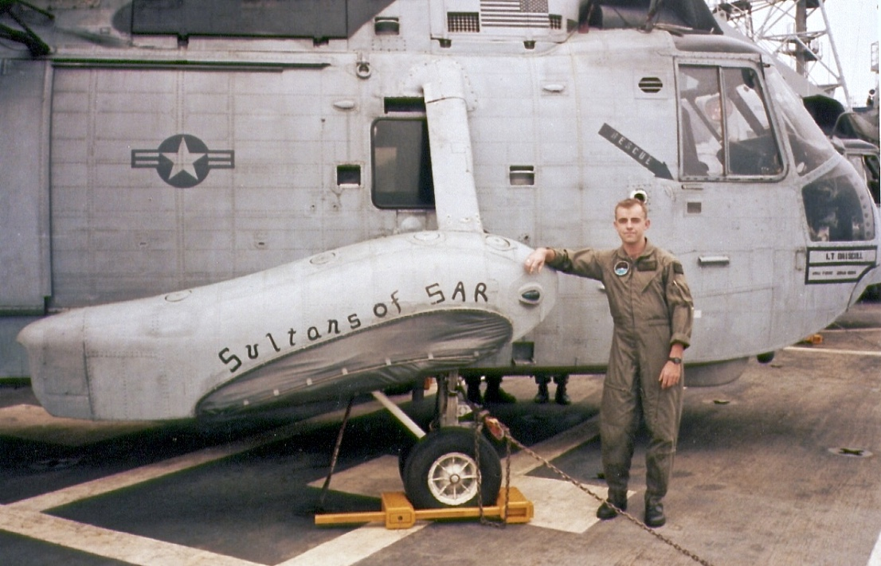
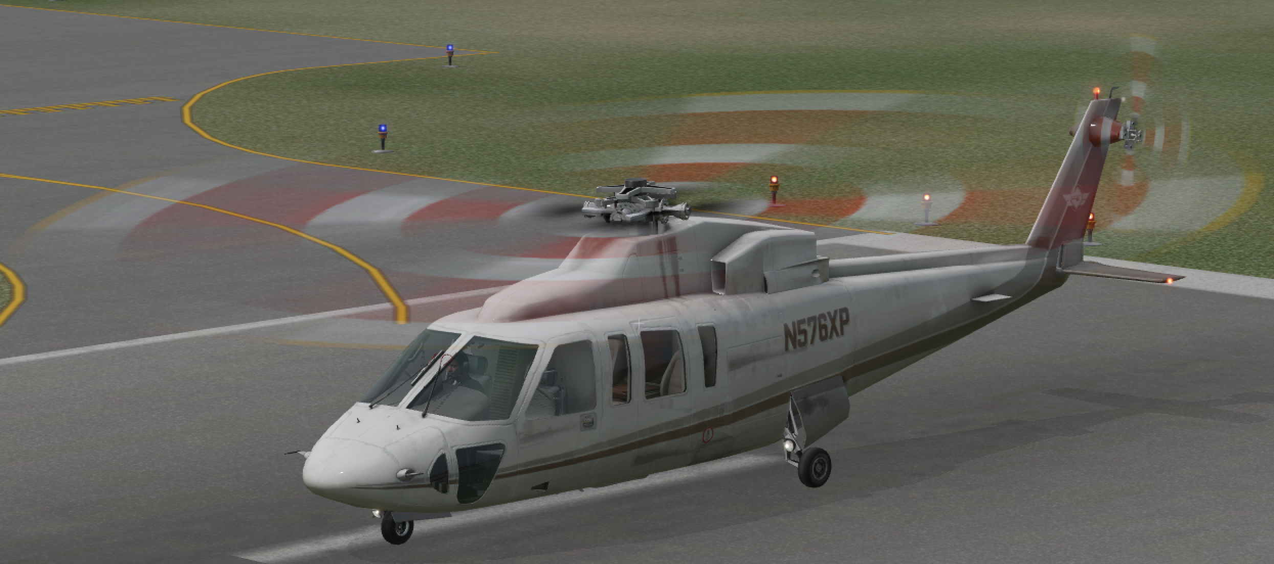
Example Usage: Extracting Text from FAA Instrument Approach Plate for Friday Harbor
Find a desired approach stored in file system
Can PyPDF2 get me here?

Slide 5
Example Usage: Extracting Text from FAA Instrument Approach Plate for Friday Harbor
#!/Library/Frameworks/Python.framework/Versions/3.6/bin/python import PyPDF2 pdfFileObj = open('/Users/brwarn/Documents/Aviation/IAP/DDTPPD_201703/06598N34.PDF','rb') pdfReader = PyPDF2.PdfFileReader(pdfFileObj) pageObj = pdfReader.getPage(0) pdftext=pageObj.extractText() print(pdftext)

Slide 6
Example Usage: Extracting Text from FAA Instrument Approach Plate for Friday Harbor
raphael:session03 brwarn$ ./pdf.py
PPCATEGORYBCDA22916734163402 X 750.8% UPELEV APP CRSApt ElevTDZERwy Idg 3402108113339°284FRIDAY HARBOR, WASHINGTON(FHR)FRIDAY HARBORAL-6598 (FAA)NDB RWY 34FRIDAY HARBOR, WASHINGTON(FHR)FRIDAY HARBOR48°31'N-123°01'WNDB RWY 34TWATTR 3900MSA FHR 25 NM 800-1692 (700-1)820-2NANA800-212002400FHR2300Remainwithin 10 NM159°339°CANADAUNITED STATES114°294°FRIDAY HARBOR284 FHRIAF113 NDB FHR BUICKISLNDS-34CIRCLING128.25ASOS135.675WHIDBEY APP CONCTAF118.2 285.652770110015252400 direct FHR NDB and hold, continue climb-in-hold to 2400.MISSED APPROACH: Climb to 1200 then climbing right turn to 692 (700-2)800-1687 (700-1)707 (800-2)339°159°424(18.4)146°4000(14.5) 273°3000159°Amdt 2 23SEP10Visibility reduction by helicopters NA.Circling NA west of Rwy 16-34.(22.6) 332°3000NDBFHR17061MIRL Rwy 16-34REIL Rwy 34TDZE108LLL181 NW-1, 02 MAR 2017 to 30 MAR 2017NW-1, 02 MAR 2017 to 30 MAR 2017

